Slide 1

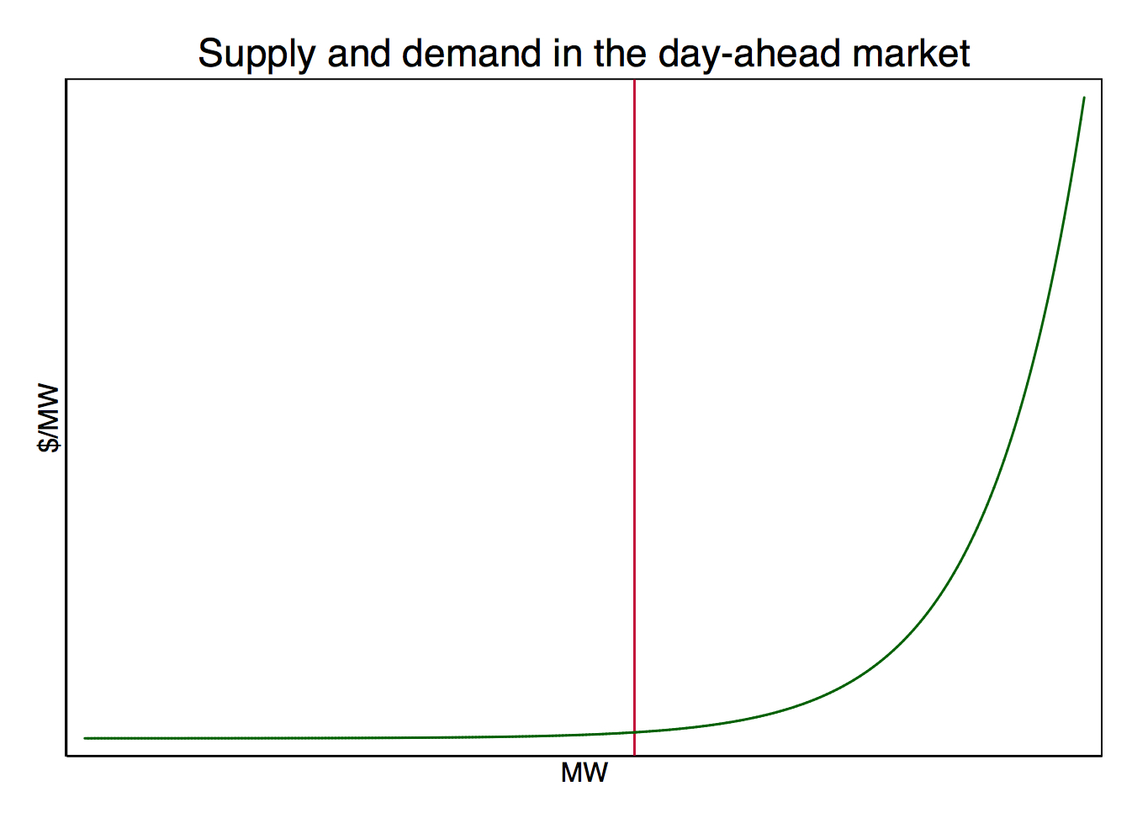
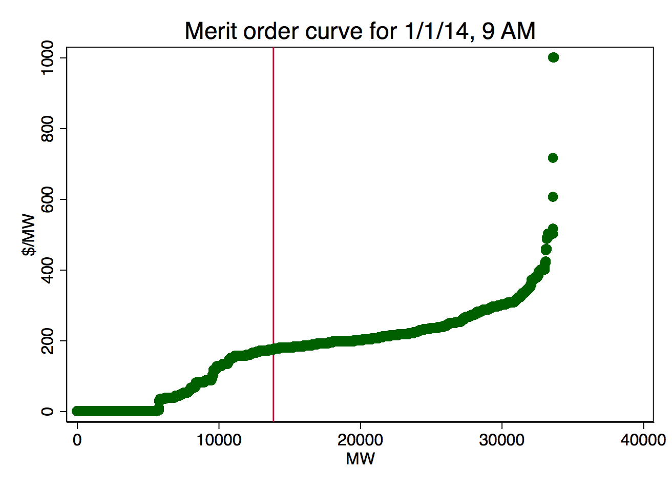
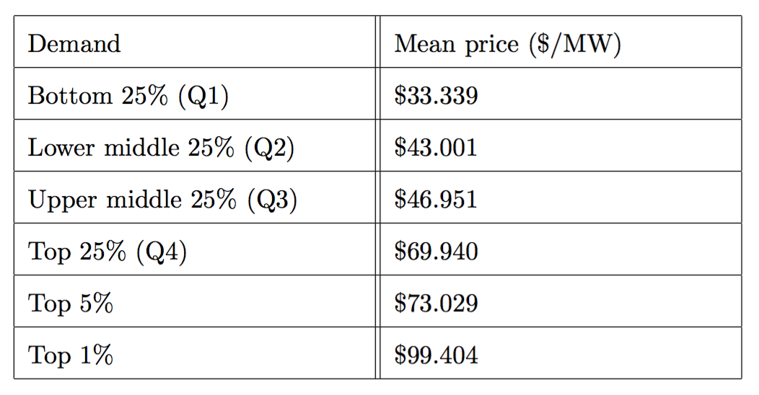
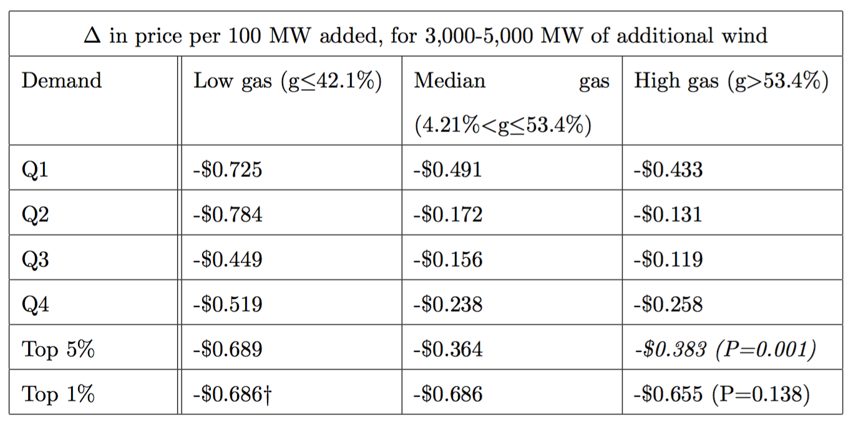
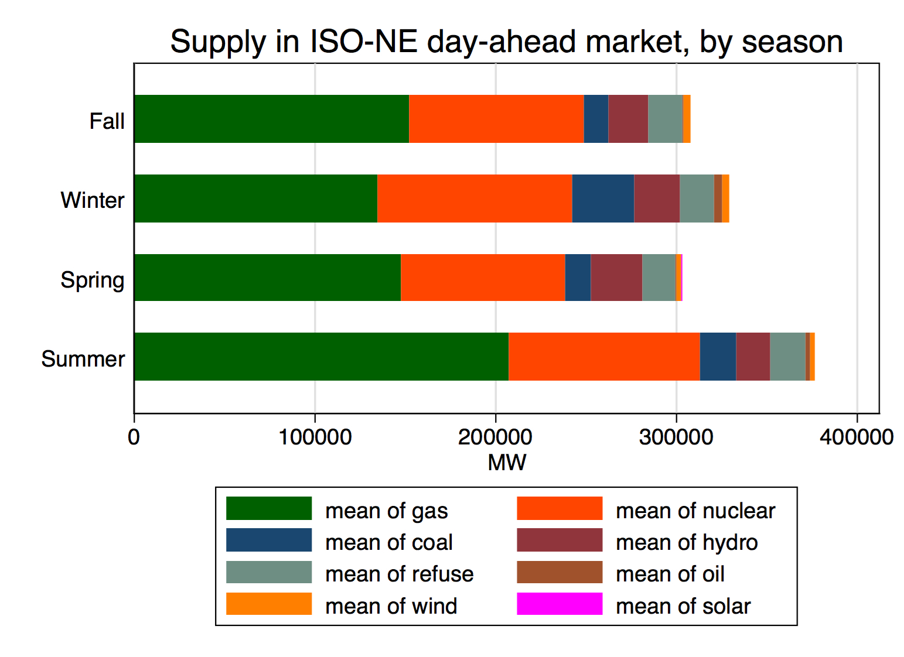
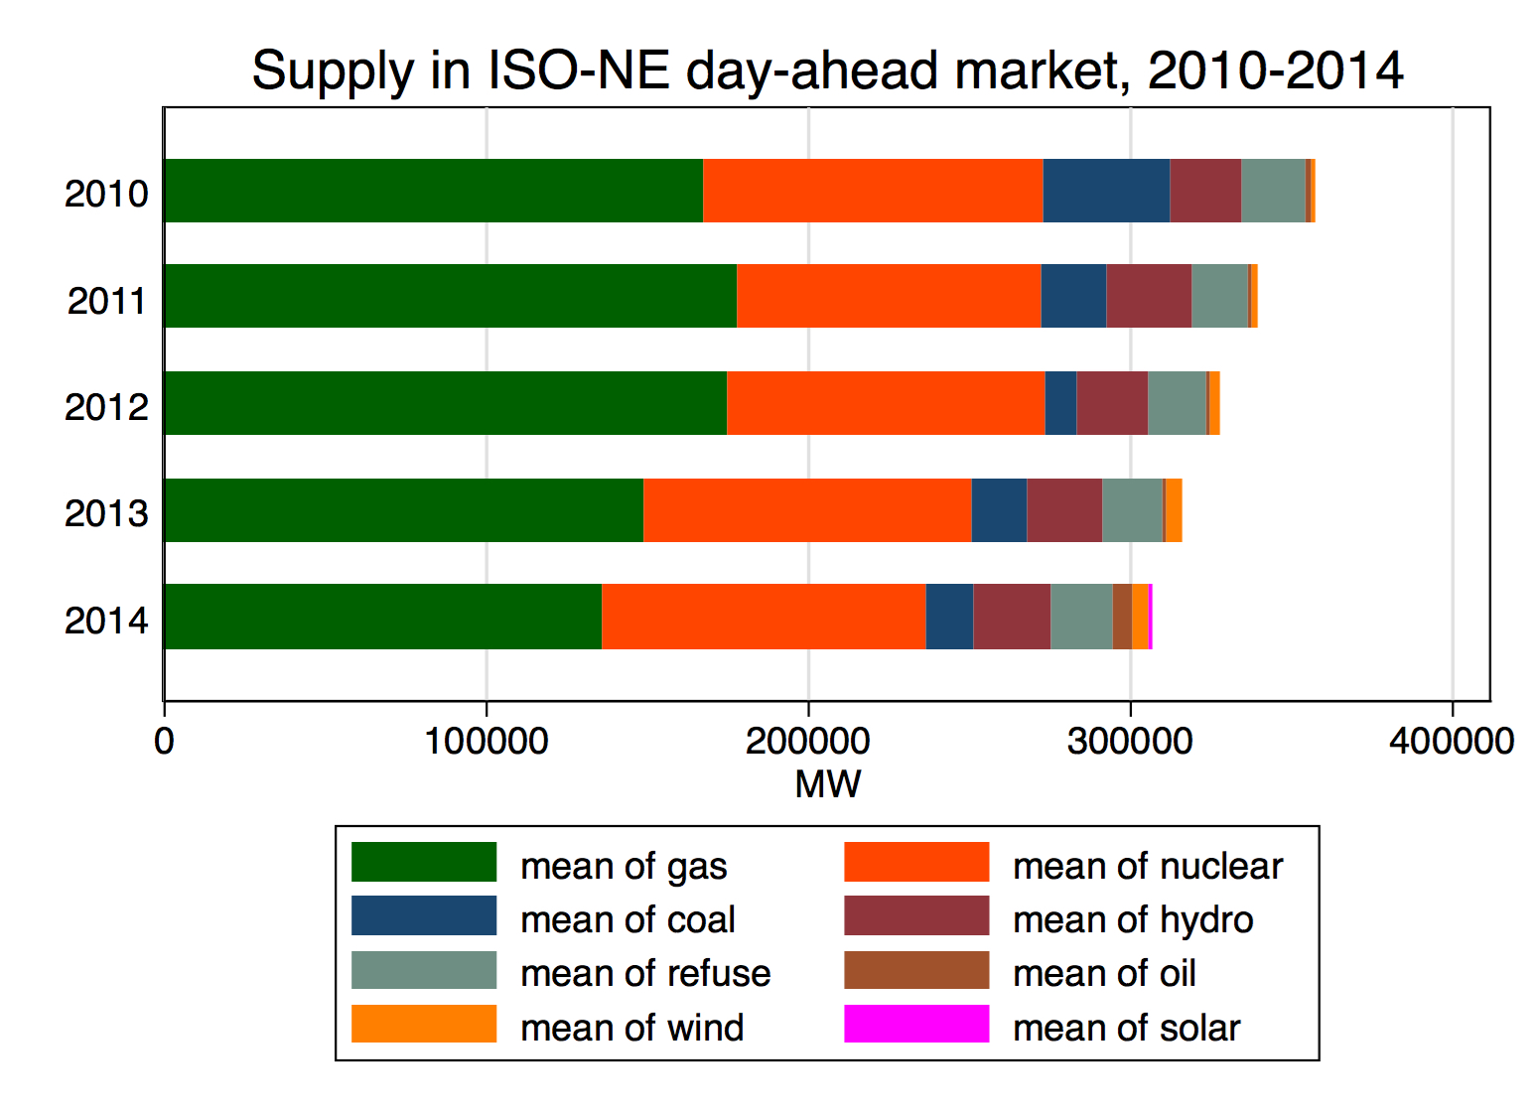
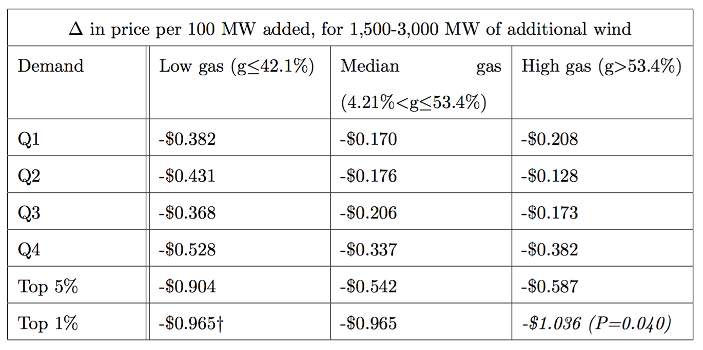

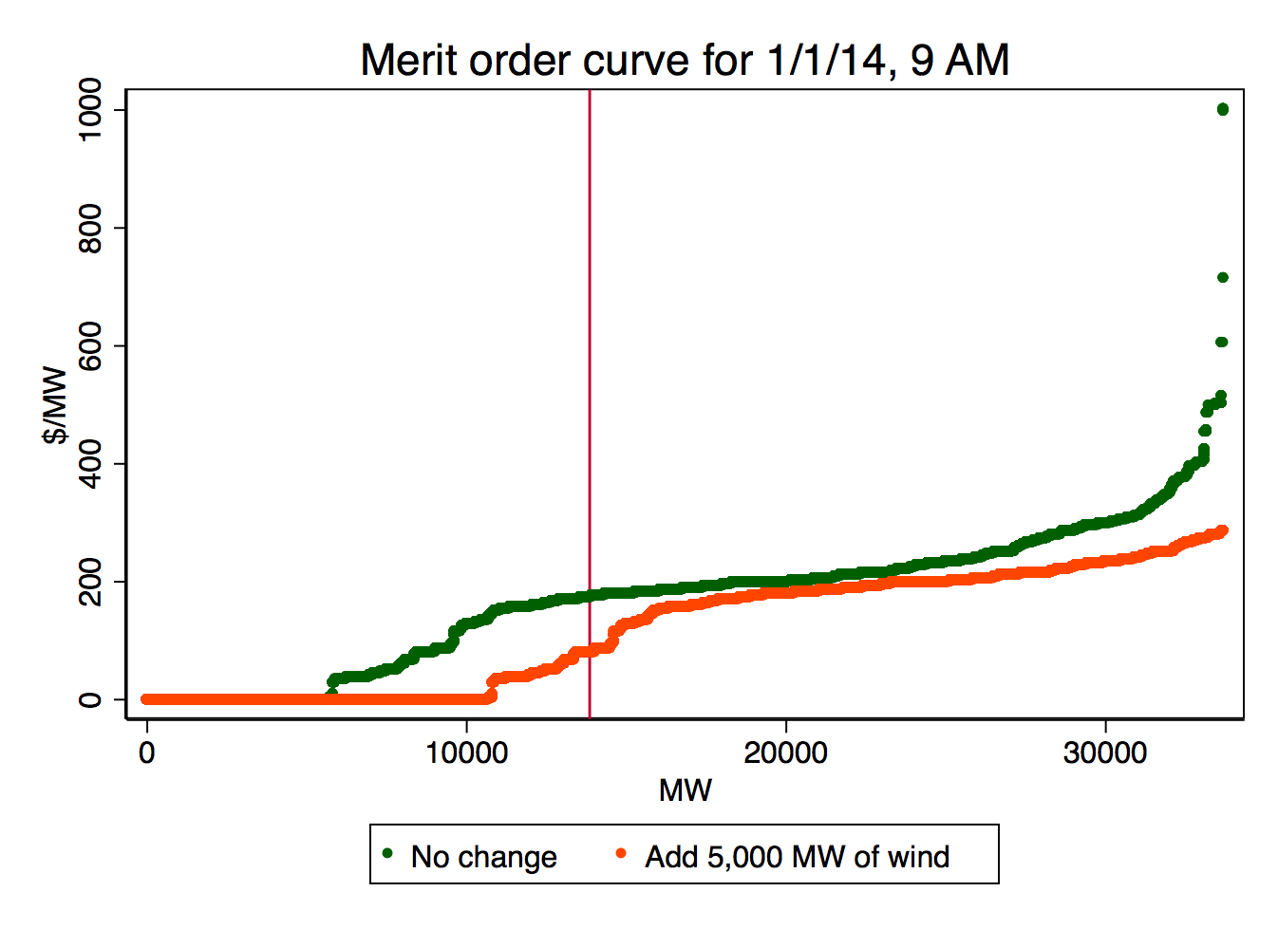
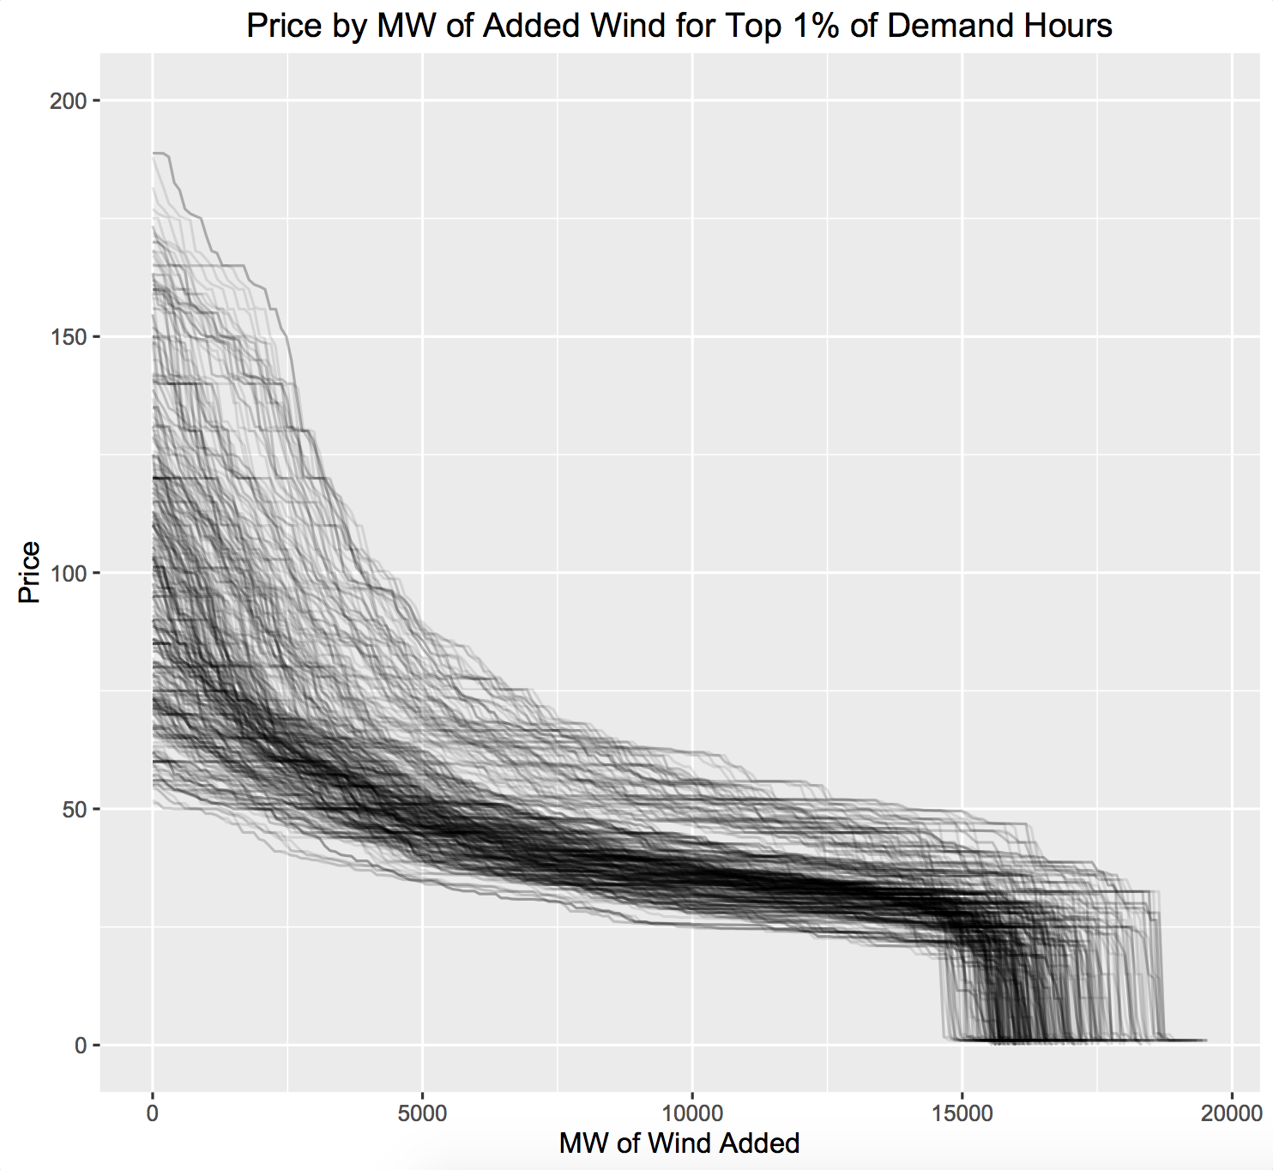
Our Grid’s Second Wind:
The effect of increased wind generation on wholesale electricity prices
Michelle Zheng ‘16
Senior Honors Thesis, Brown University Department of Economics
Computer Science-Economics, Sc.B.
michellejzh@gmail.com
Research question
How does the quantity of wind generation being bid in competitive electricity markets affect the wholesale price of electricity?
1. Supply and demand are constantly balanced to keep the lights on.
Results
When additional wind generation is added to the system, the greatest price decreases occur when demand is high and the share of natural gas making up supply is great.
Hypothesis
Bid in by wind generators at $0.00 marginal cost, wind energy should decrease prices at levels varying by:
the quantity of wind added to the market,
the level of demand, and
the marginal costs and quantities of other resources on the market.
Schematic Actual
2. The resource mix making up supply varies seasonally and annually with market trends.
Methodology
I estimate the impact of increased wind penetration under different quantity, demand, and resource mix scenarios by simulating the market mechanism using historical market data and evaluating the price changes that result. I look specifically for this effect at the day-ahead market administered by the New England ISO (ISO-NE), which accounts for about 30-40% of the energy procured in this region of 14 million customers.
The simulation is written in Python, and calculates the clearing price that would have occurred on each hour throughout 2010-2014, for additional quantities of up to 5,000 MW in increments of 100 MW.
3. Increased wind generation is added to the supply curve at $0.00, shifting the supply curve to the right and decreasing price.
Conclusion
By simulating the direct effect of increased wind supply on ISO-NE’s day-ahead electricity market, I have created estimations of the effects of different levels of additional wind on the market clearing price, as varying by the level of demand and share of supply provided by natural gas. These show that reductions in price are greatest when the percentage share of natural gas and level of demand are very high, due to the steepness of the rightmost side of the bid curve which is accessed under these conditions.
Though wind’s share of supply in New England is currently still small, providing only about 1% of supply on average, this is set to change. State-sponsored programs and falling technology costs have made wind one of the fastest growing resources in the world. With more than 4,000 MW of proposed wind projects currently under consideration by ISO-NE, such savings in energy cost for the grid are soon to come.
Data
Data comes from ISO-NE, and includes hourly data on day-ahead market participants’ offers, hourly data on day-ahead market demand, and daily data on the resource mix, for each day from 2010-2014.
The shape of the supply curve directly determines price and price stability, mapping each level of demand to price. Holding demand fixed, the two changes in the supply curve that can lead to a decrease in the clearing price are 1) the decrease in the price of any generation to the right of demand to a price below the clearing price, and 2) the entry of any generation to the left of demand. Renewable resources like wind bidding in at $0.00 decrease price through the second condition, pushing all other bids to the right.

